Slide 2


Baby On Board
The Portable Medical Assistant
Team 28: In My Feelings
Mehvish Ali, Chogozie Ofodike, Jose Maldonado

Slide 3

Home Screen
Soft Colors
Baby Blue, Cream
Feminine Design
Pink, Cursive
Maternal Symbolism
Angel Feathers, Felines
Interesting Graphics
Easy Navigation

Slide 4
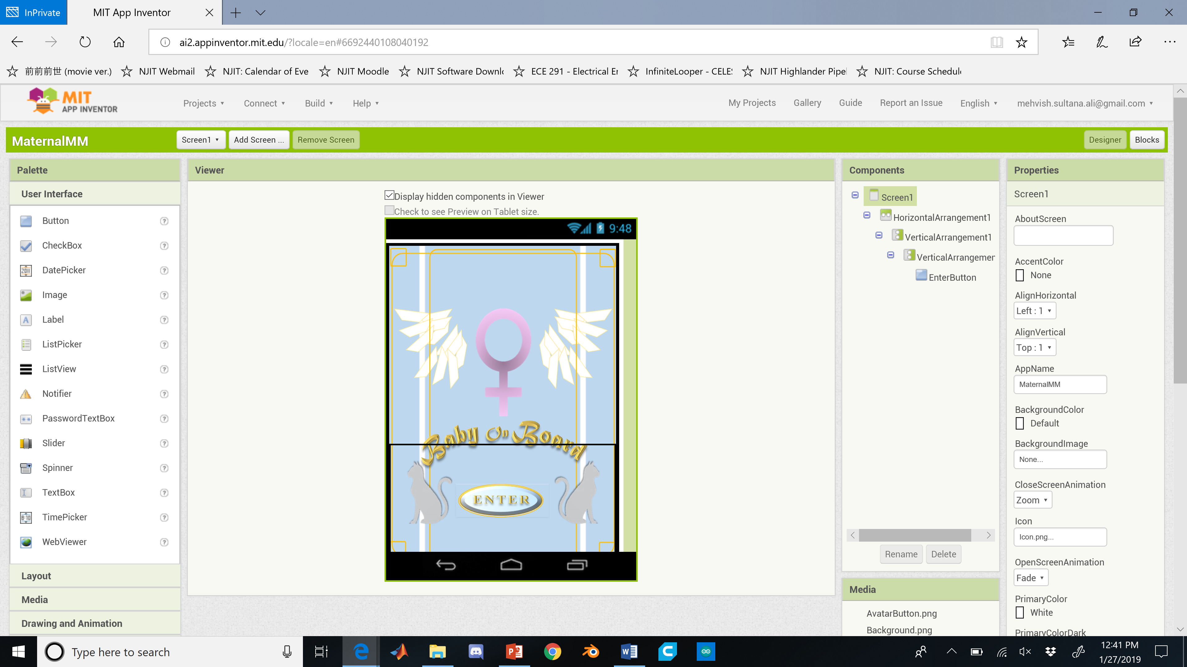

Slide 5





Loading Screen
Maternal Imagery
Baby Chicks and Eggs
Interesting Facts
Dangerous Warning Signs
Medical Care for Women
Medical Care for Infants

Slide 6





 . . . 

Slide 7
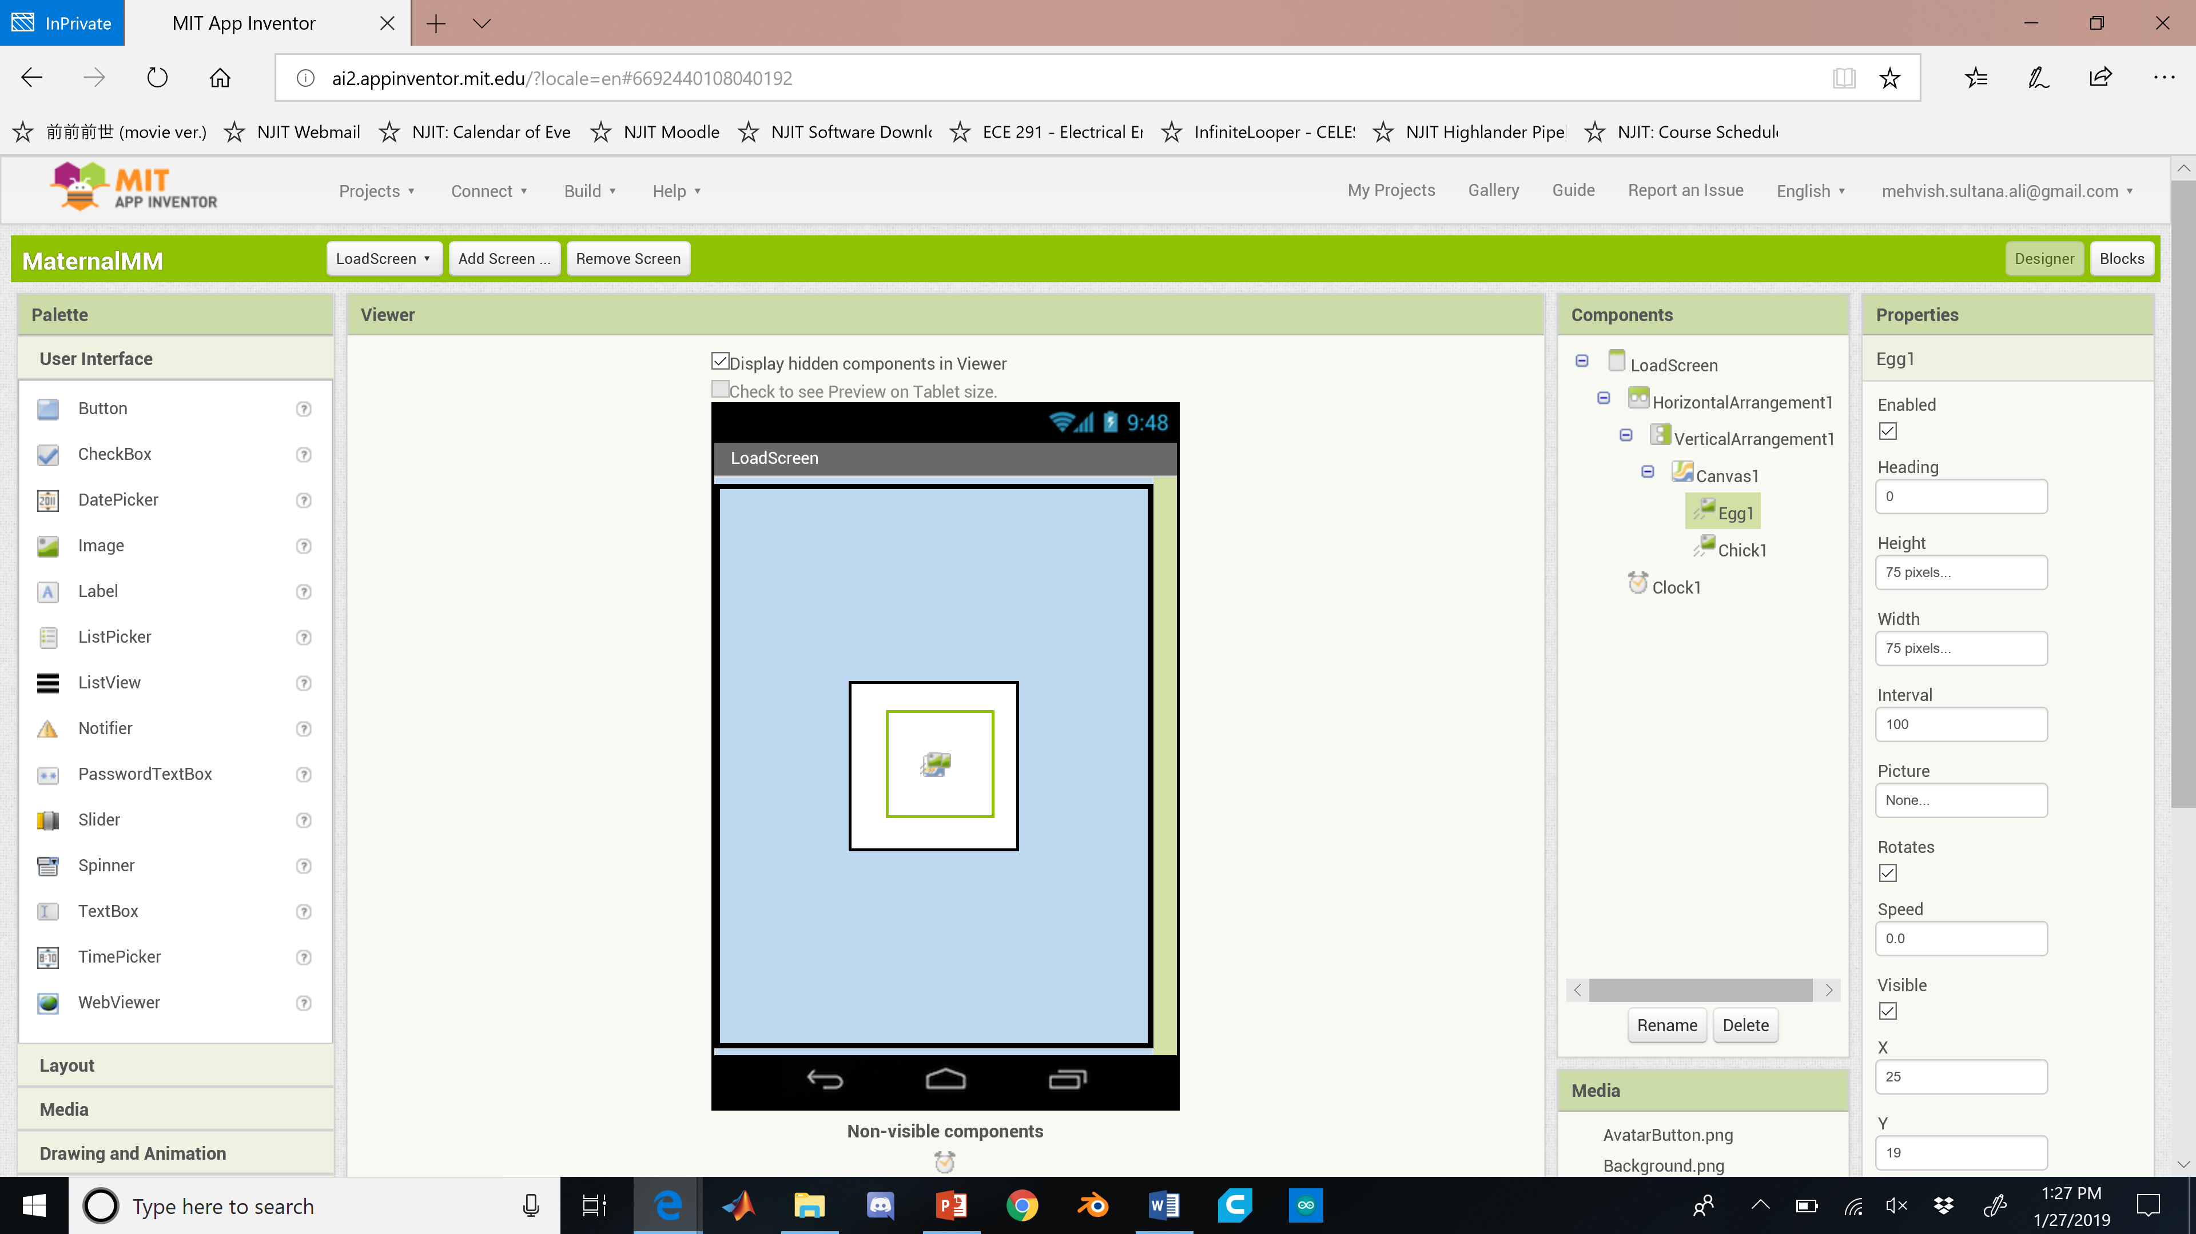

Slide 8



Symptoms
 Jane Doe 
User Select
Medical Avatar
Easy Navigation
Head
Chest / Abdomen
Limbs
Upper Right
Upper Left
Lower Right
Lower Left

Slide 9
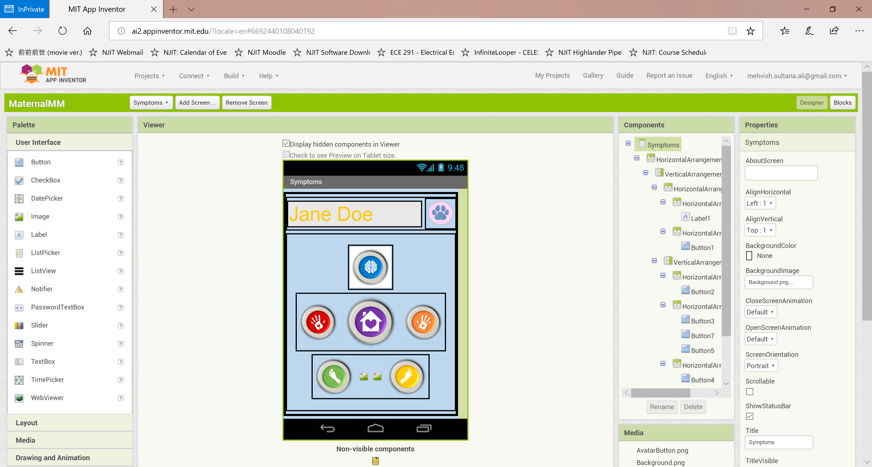

Slide 10
Medical File
 Jane Doe 
Portable Medical History
Unique ID
Updatable by Doctor (Unique Key)
Patient-Doctor Accessible
Patient Portal Source
Up-to-Date
Lab Availability
Name: Janice Dinah Doeregard
Date of Birth: March 15, 1987
Blood Type: O (Negative)
Address: 17 South Street, Rahway, NJ 08961
Relationship Status: Married
Pregnancy: Prenatal
.
Labs:
03/26/16
05/23/17
Insurance:

Slide 11
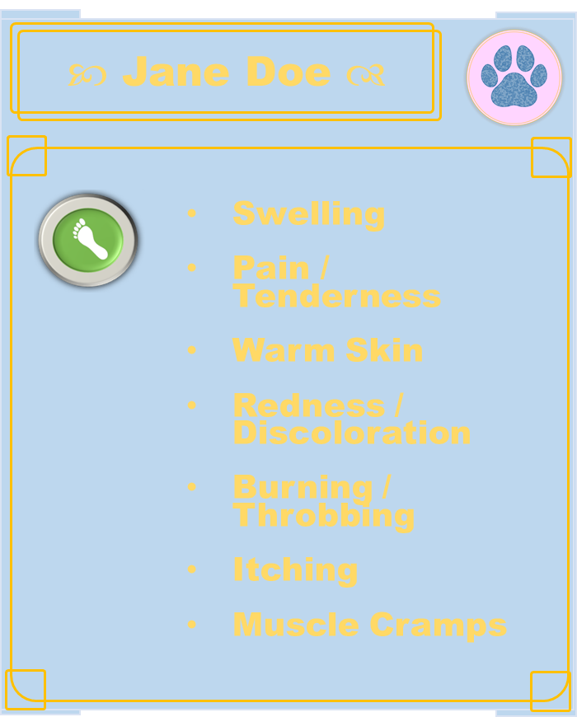
Symptom Select
 Jane Doe 
Associated Symptoms
Most Common vs. ABC Order
Internal Checklist
Risk Factor by Percentage
Rank Increases w/ Pregnancy
Emergency Alert
Updates Emergency Contacts
Swelling
Pain / Tenderness
Warm Skin
Redness / Discoloration
Burning / Throbbing
Itching
Muscle Cramps

Slide 12



Citations
Microsoft PowerPoint
Graphics.
Google Images
Various ClipArt.
MIT AppInventor II
It crashes on the Home Page. D:
Database – FirebaseDB
… Supposedly. >:C
Java
One day…

Slide 13
Questions?

Slide 14
.THE END.

